Slide 1



UNIT 3
LESSON 10
Did you know?
Part 3

Slide 2
The central span of the bridge can be raised to allow ships to pass.
The statue's crown bears seven spikes, symbolizing the seven oceans and seven continents of the world, and emphasizing her message of welcome, inclusiveness, and freedom.
Tower Bridge
The Statue of Liberty
There are 132 rooms, 32 bathrooms, and 6 levels to accommodate all the people who live and work in. There are also 412 doors, 147 windows, 28 fireplaces, 7 staircases, and 3 elevators.
The White House
Emily Warren Roebling was the first human to make the trip across the historic bridge, riding proudly in a carriage a week before its official opening in front of an audience. Sitting in Emily’s lap all the time was a rooster, a symbol of good luck.
The Brooklyn Bridge

Slide 3
I see | I hear | I smell | I feel
helicopter
steam
light bulb
dynamite
penicillin
telephone
radium
the Nobel prize
Ancient Greece
chemistry
explosive
inventor
scientist
engineer
DNA
flop
alternating
winner
current Congratulations
a $9 million fund

Slide 4
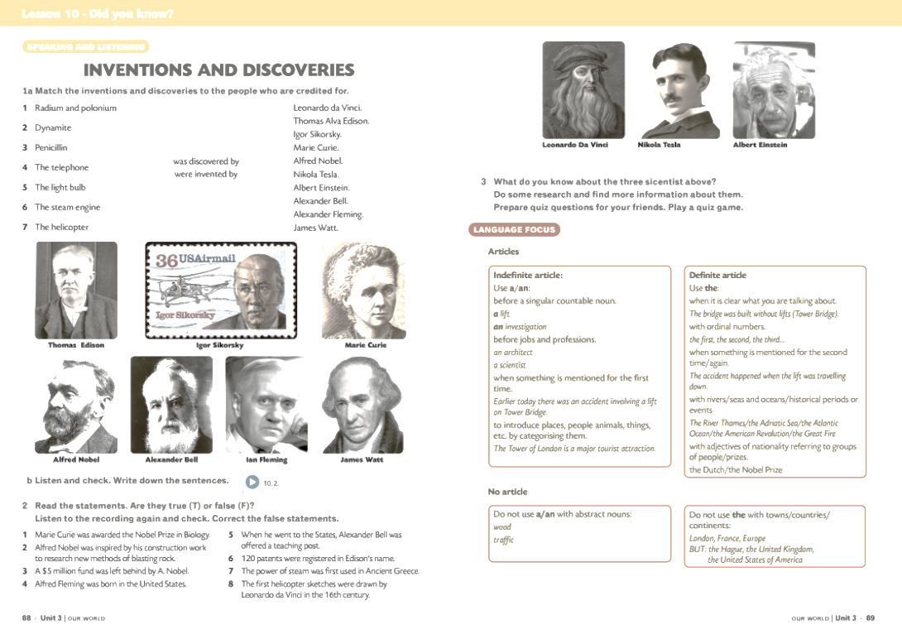
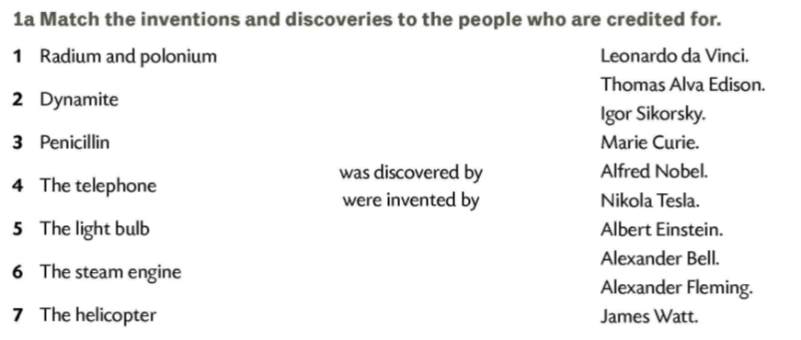
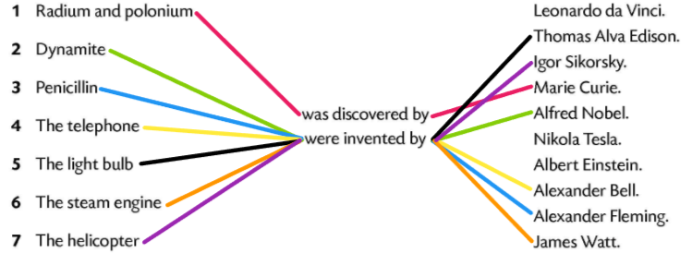

Marie Curie
Alfred Nobel
Alexander Fleming
Alexander Bell
Thomas Alva Edison
James Watt
Igor Sikorsky

Slide 5
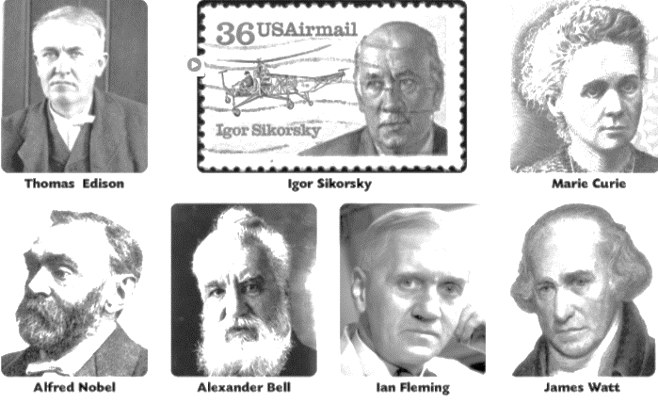
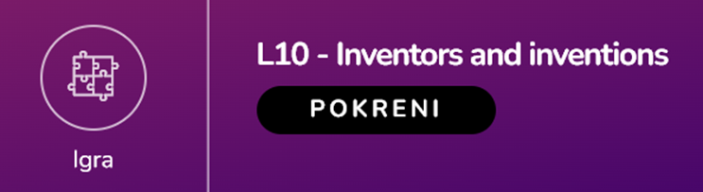
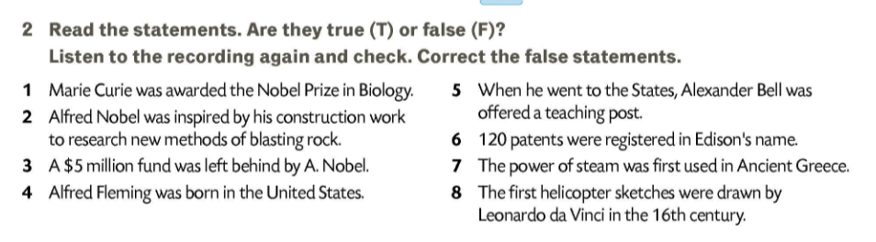
chemistry
F
T
T
1 300
F
9 million dollars
F
T
Scotland
F
T

Slide 6
